Slide 1
Korolev Sergey Pavlovich is a great scientist
Author: SERIKOV VASILY
GROUP: б03-102

Slide 2
plan:
1) Biography of the scientist.
2) His contribution to science.
3) Memory of the scientist.

Slide 3
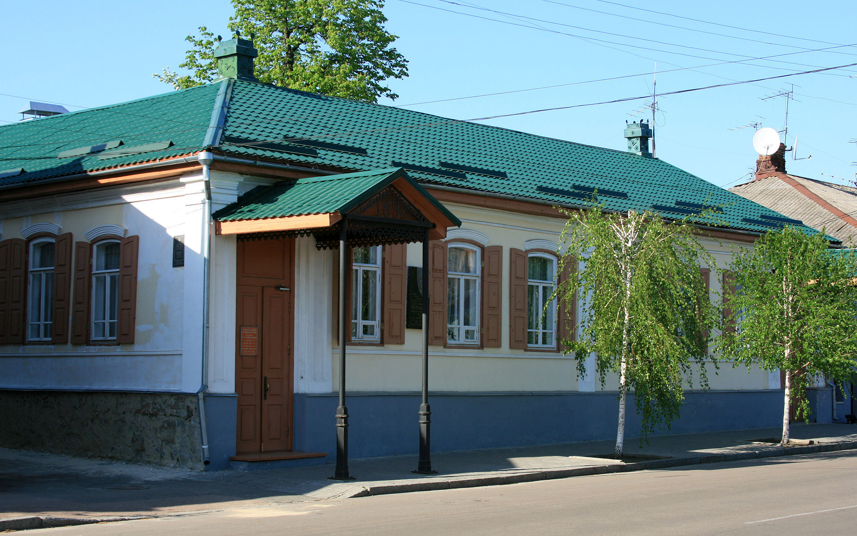
The scientist house

Slide 4
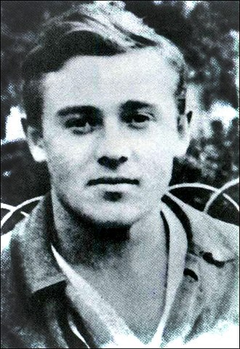
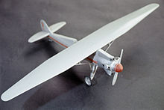
Early career
The Korolev's plane
Korolev in 1920

Slide 5
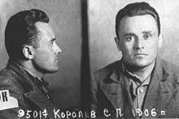
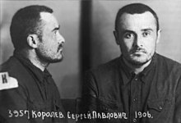
arrest and live in prison
Before prison
After prison

Slide 6
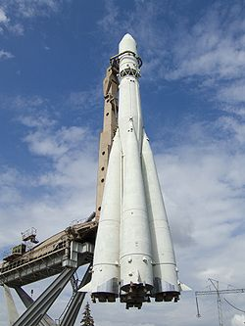
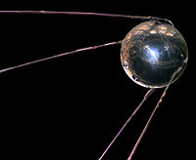
scientific achievements
The first artificial satellite
of the Earth
The first manned
spacecraft "Vostok-1"

Slide 7
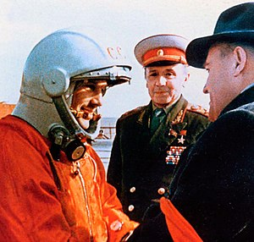
scientific achievements
Gagarin and Korolev before the start

Slide 8
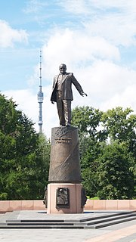
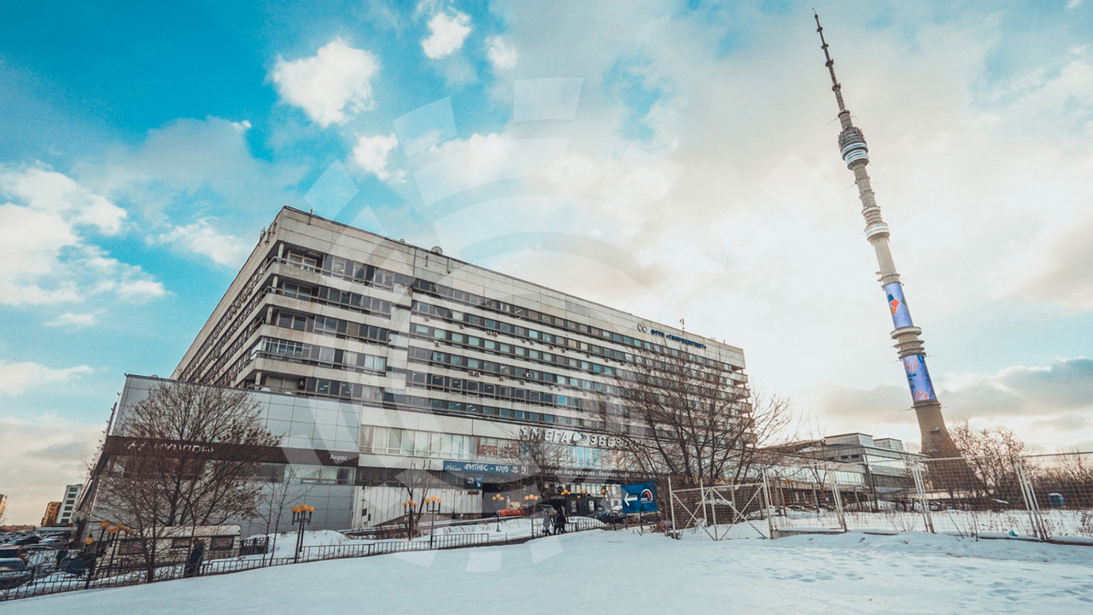
Memory of the scientist
Akademika Koroleva Street
Monument in Moscow

Slide 9
thanks for your attention

